Slide 1
Kolla
Ansible Deployment + OpenStack in Docker Containers = Operator Bliss
Steven Dake, Cisco Systems
Sam Yaple, Servosity
Principal Engineer
Senior DevOps Engineer
October 29th, 2015

Slide 2
Beyond the Stack
Cisco is committed to helping
Build, Deploy, Scale, and Connect
your OpenStack clouds

Slide 3
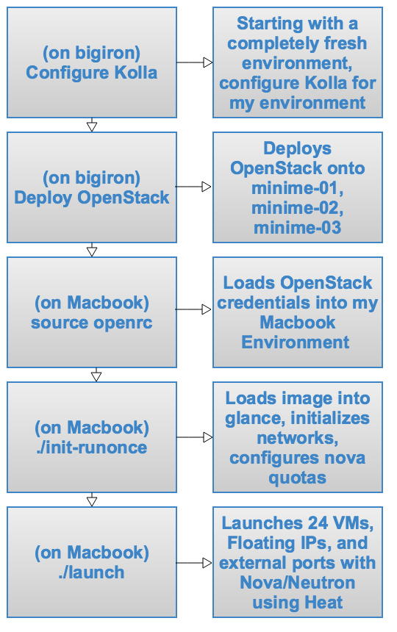
Demo Agenda

Slide 4
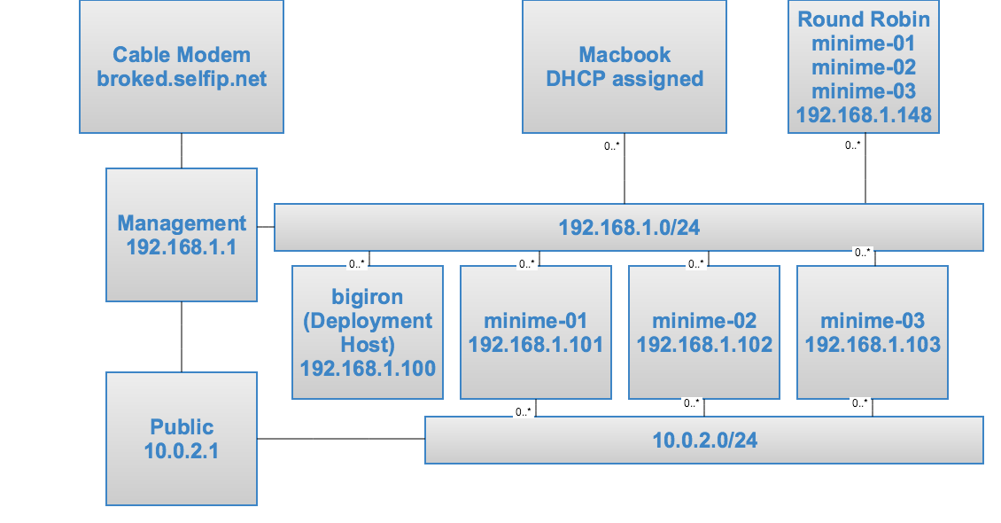
Home Lab Configuration

Slide 5
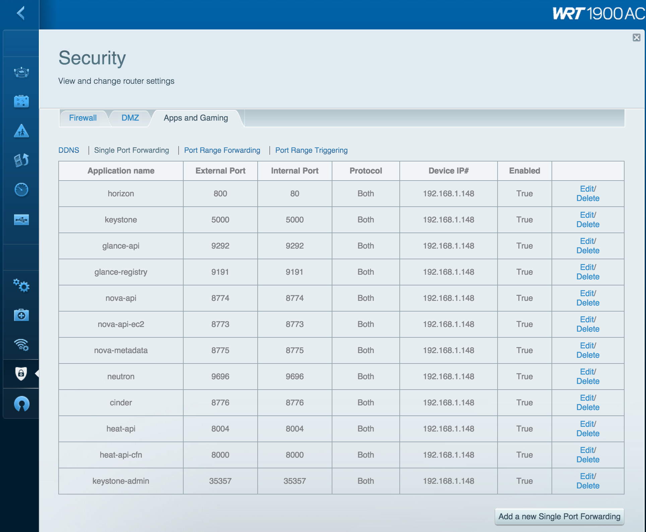
WRT1900AC NAT setup

Slide 6
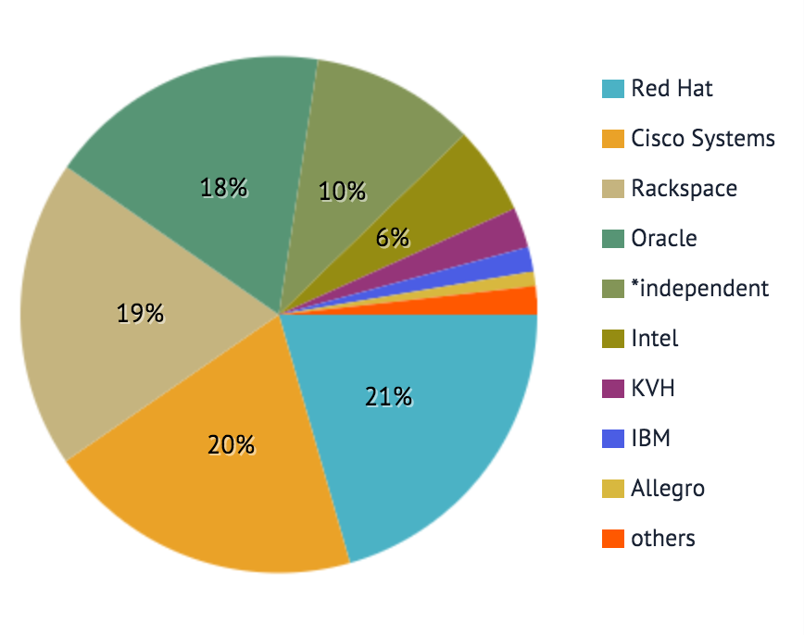
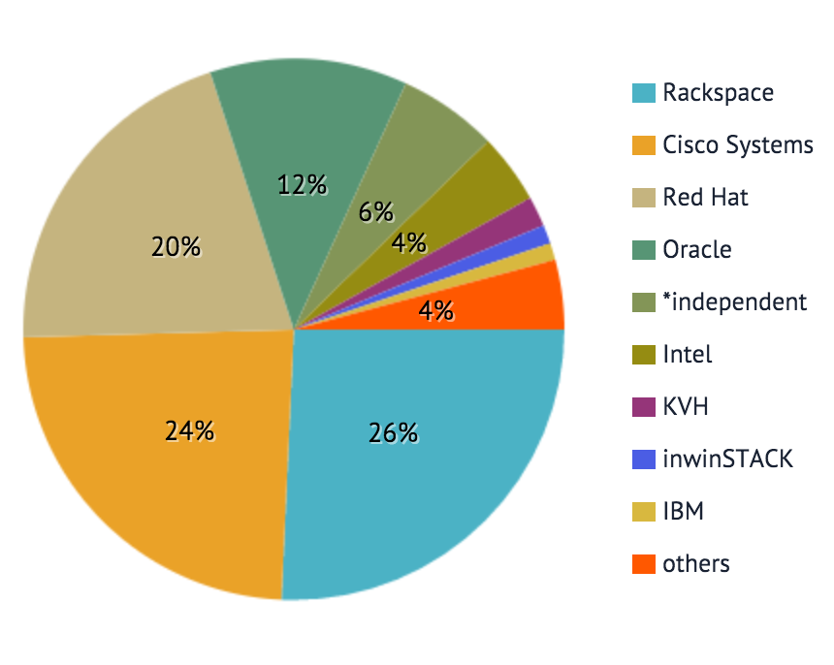
Kolla Community
Team-diversity tagged
Liberty Reviews
Liberty Commits

Slide 7
What is Kolla?
N-Way active high availability
Full immutable infrastructure
Ceph backed storage
Distro choice of CentOS, Oracle Linux, RHEL, Ubuntu
Build from packages or build from source
Intent is to deploy the big tent at 100 node scale
Small runtime dependency footprint of docker-py and docker-engine
Currently deploy ceph, mariadb, rabbitmq, memcached, glance, keystone, nova, neutron (ovs & linuxbridge), murano, heat, cinder, swift, ironic
Docker containers for atomic upgrades
Deploy reconfigures and updates
Minimal operational dependencies
Full customization of the OpenStack available

Slide 8
What is Kolla: Principles
Designed by Community
Designed for scale
Designed for choice
Executed exception free

Slide 9
What is Kolla: Technology
FROM {{ namespace }}/{{ image_prefix }}heat-base:{{ tag }}
MAINTAINER Kolla Project (https://launchpad.net/kolla)
{% if install_type == 'binary' %}
{% if base_distro in ['centos', 'fedora', 'oraclelinux', 'rhel'] %}
RUN yum -y install openstack-heat-api \
&& yum clean all
{% endif %}
{% endif %}
COPY extend_start.sh /usr/local/bin/kolla_extend_start
RUN chmod 755 /usr/local/bin/kolla_extend_start

Slide 10
What is Kolla: Technology
Ansible processes main.yml
Ansible processes config.yml
Customization augementation files merged with opinionated configuration templates
JSON configuration copied
Merged config files copied to bind-mount
Ansible proccesses bootstrap.yml
Create service database
Create service database user
Start bootstrap container
Cleanup bootstrap container
Ansible processes start.yml
Final container started

Slide 11
What is Kolla: Validation
Each change goes through a gating process which consists of:
2-ACK review process
Build for all distributions all containers
Build a smaller subset of containers and deploy them
(In the future run test cases against the deployed cloud)

Slide 12
Demo Agenda

Slide 13
The contents of openrc
export OS_PROJECT_DOMAIN_ID=default
export OS_USER_DOMAIN_ID=default
export OS_PROJECT_NAME=admin
export OS_USERNAME=admin
export OS_PASSWORD=password
export OS_AUTH_URL=http://broked.selfip.net:5000

Slide 14
The contents of launch
VM_COUNT=24
IMAGE_FLAVOR=m1.small
PUBLIC_NET_ID=$(neutron net-list | grep public | awk '{print $2}')
DEMO_NET_ID=$(neutron net-list | grep demo | awk '{print $2}')
DEMO_SUBNET_ID=$(neutron net-list | grep demo | awk '{print $6}')
heat stack-create steak --template-file steak-rg.yaml --parameters="vm_count=$VM_COUNT;image_flavor=$IMAGE_FLAVOR;public_net_id=$PUBLIC_NET_ID;demo_net_id=$DEMO_NET_ID;demo_subnet_id=$DEMO_SUBNET_ID

Slide 15
The resources of steak-rg.yaml
resources:
steak:
type: OS::Heat::ResourceGroup
properties:
count:
get_param: vm_count
resource_def:
type: steak.yaml
properties:
image_flavor: {get_param: image_flavor}
public_net_id: {get_param: public_net_id}
demo_net_id: {get_param: demo_net_id}
demo_subnet_id: {get_param: demo_subnet_id}

Slide 16
The resources of steak.yaml
steak_node_eth0:
type: "OS::Neutron::Port"
properties:
network_id:
get_param: demo_net_id
fixed_ips:
- subnet_id:
get_param: demo_subnet_id
resources:
steak_node:
type: "OS::Nova::Server"
properties:
key_name: mykey
image: cirros
flavor:
get_param: image_flavor
networks:
- port:
get_resource: steak_node_eth0
steak_node_floating:
type: "OS::Neutron::FloatingIP"
properties:
floating_network_id:
get_param: public_net_id
port_id:
get_resource: steak_node_eth0

Slide 17
Thank You

